Slide 1

Riya Goyal

Slide 2
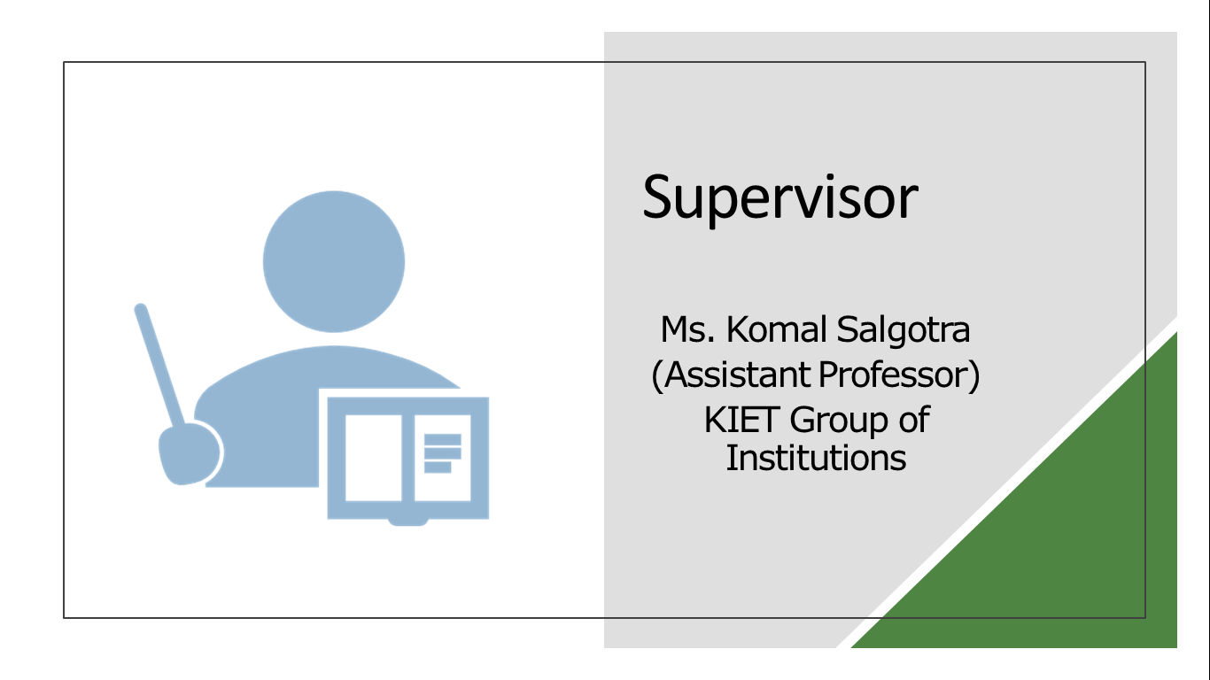

Slide 3
What ?
The project will prioritize security and privacy to ensure the confidentiality and integrity of research data. Strong encryption, access control and authentication procedures will be used to protect sensitive information and reduce risks associated with data breaches.
This project aims to solve the limitations of existing solutions by creating and using advanced online analytics. An online survey that uses digital technology and best practices in creating user experience. The system will provide a user-friendly interface, dynamic survey design capabilities, real-time responses and powerful

Slide 4
Objective
The main objectives of the project are listed below:
To develop a comprehensive and user-centric platform for conducting surveys in various domains
To address the limitations of existing survey solutions while leveraging technological advancements to enhance usability, efficiency, and data quality.
Secondly,
User friendly
Dynamic Questionnaire Design
Real-Time Response Tracking
Security and Privacy

Slide 5
Features
Real-Time Survey Deployment
Multimedia Integration
Customizable Themes and Branding
Survey Templates
Collaboration and Sharing

Slide 6
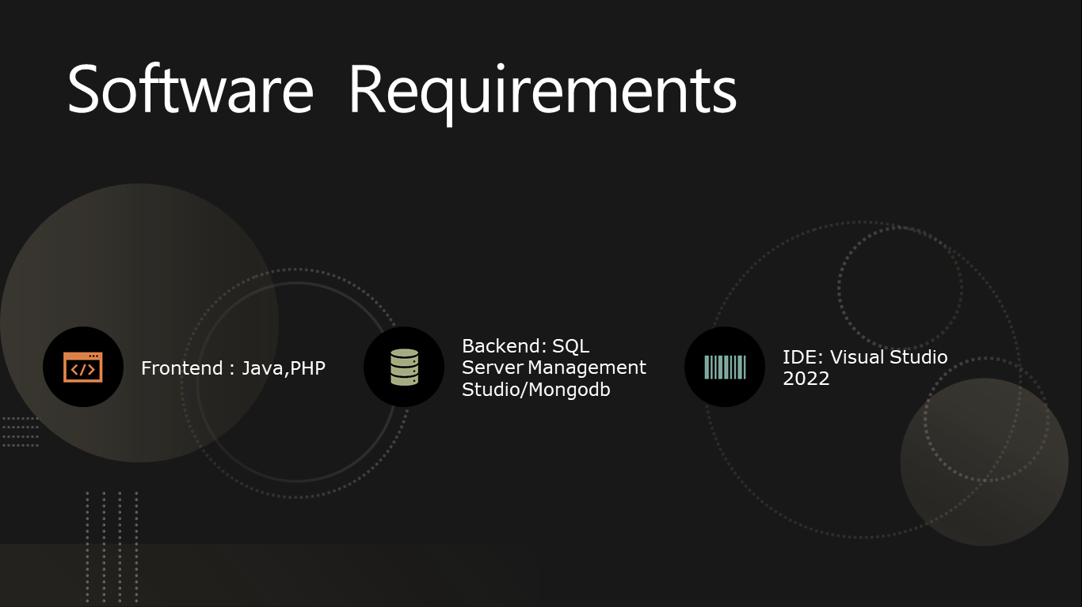

Slide 7
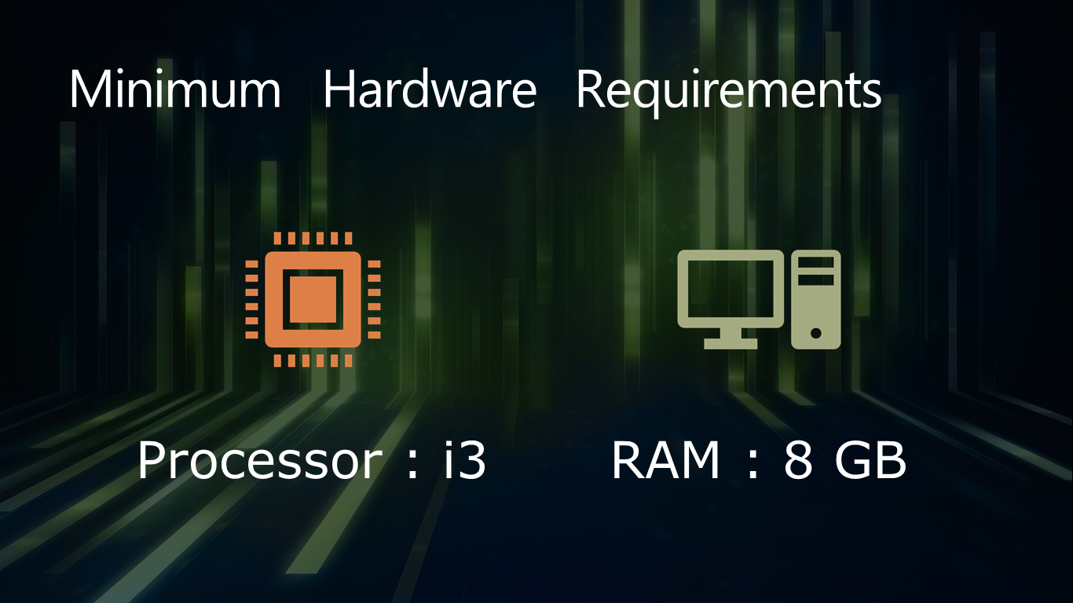

Slide 8
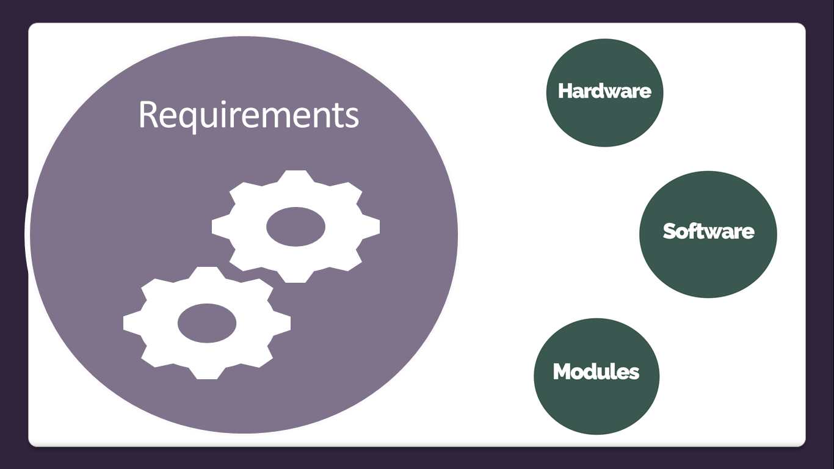

Slide 9


Slide 10
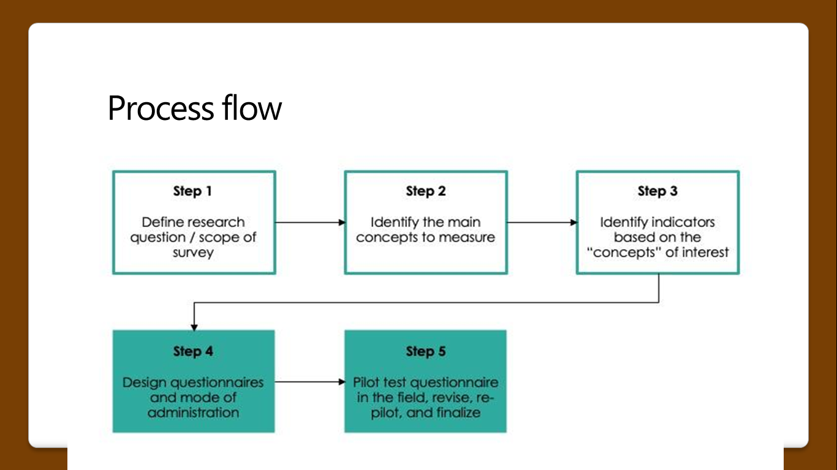

Slide 11
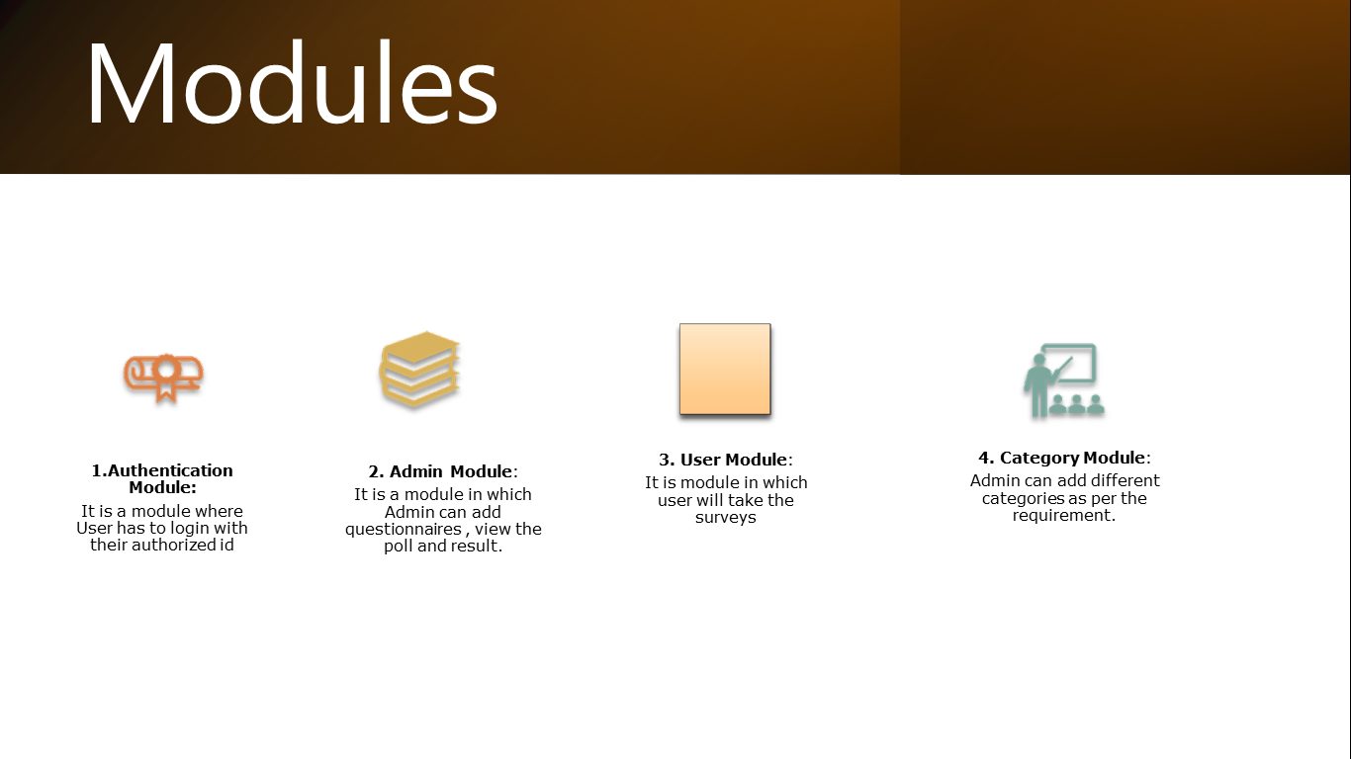

Slide 12
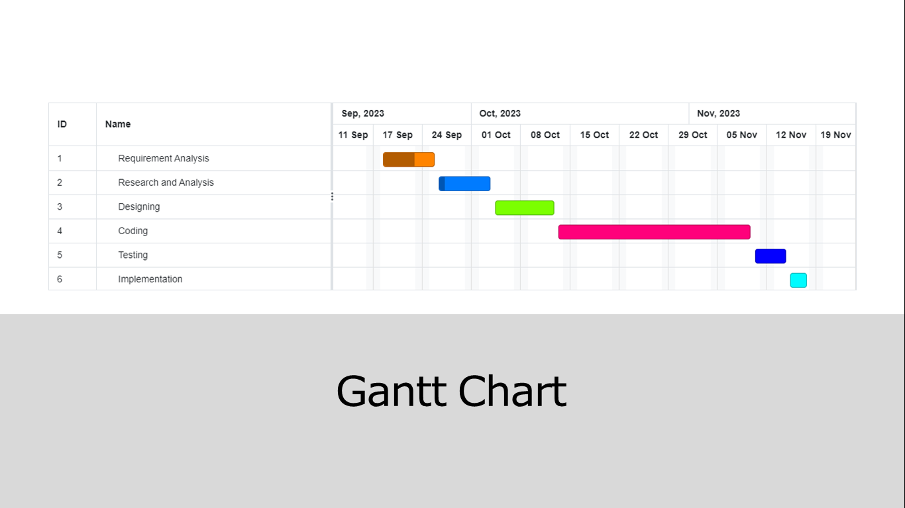

Slide 13


